Slide 1
Executive Summary
DDS Analytics is analyzing talent management solutions for Fortune 100 companies. To gain a competitive edge over the competition they want to use data science for talent management. They want to investigate salary prediction and attrition classification using data science techniques.

Slide 2
Agenda
Summary Statistics
Attrition Factors
Trends in Data
Classification Model
Regression Model
Conclusion

Slide 3
Summary Statistics
870 Observations with 36 variables
No missing data
Average values for variables ➔

Slide 4
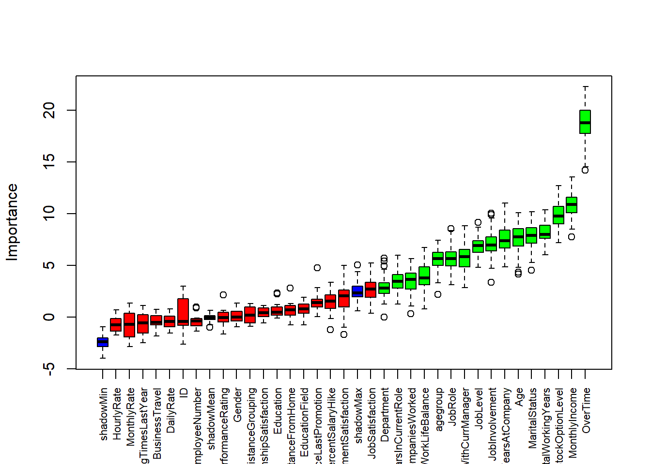
Attrition Factors
Top 3 factors :
Overtime
Monthly Income
Stock Option Level

Slide 5
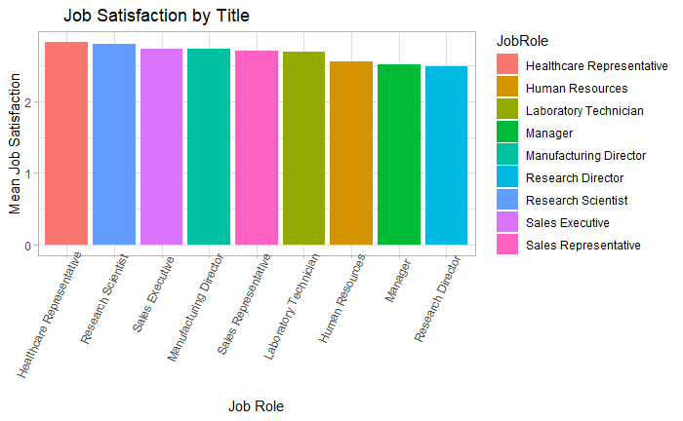
Interesting Trends in Data
Job Satisfaction by Title
HR Represenative
Years with company
XYZ

Slide 6
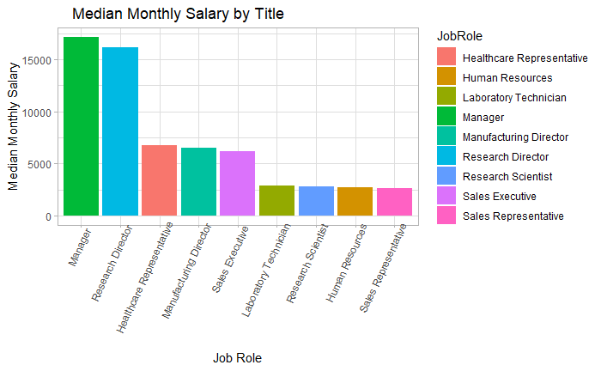
Interesting Trends in Data
Median Monthly Salary by Title
Manager
Research Director
HR Rep

Slide 7
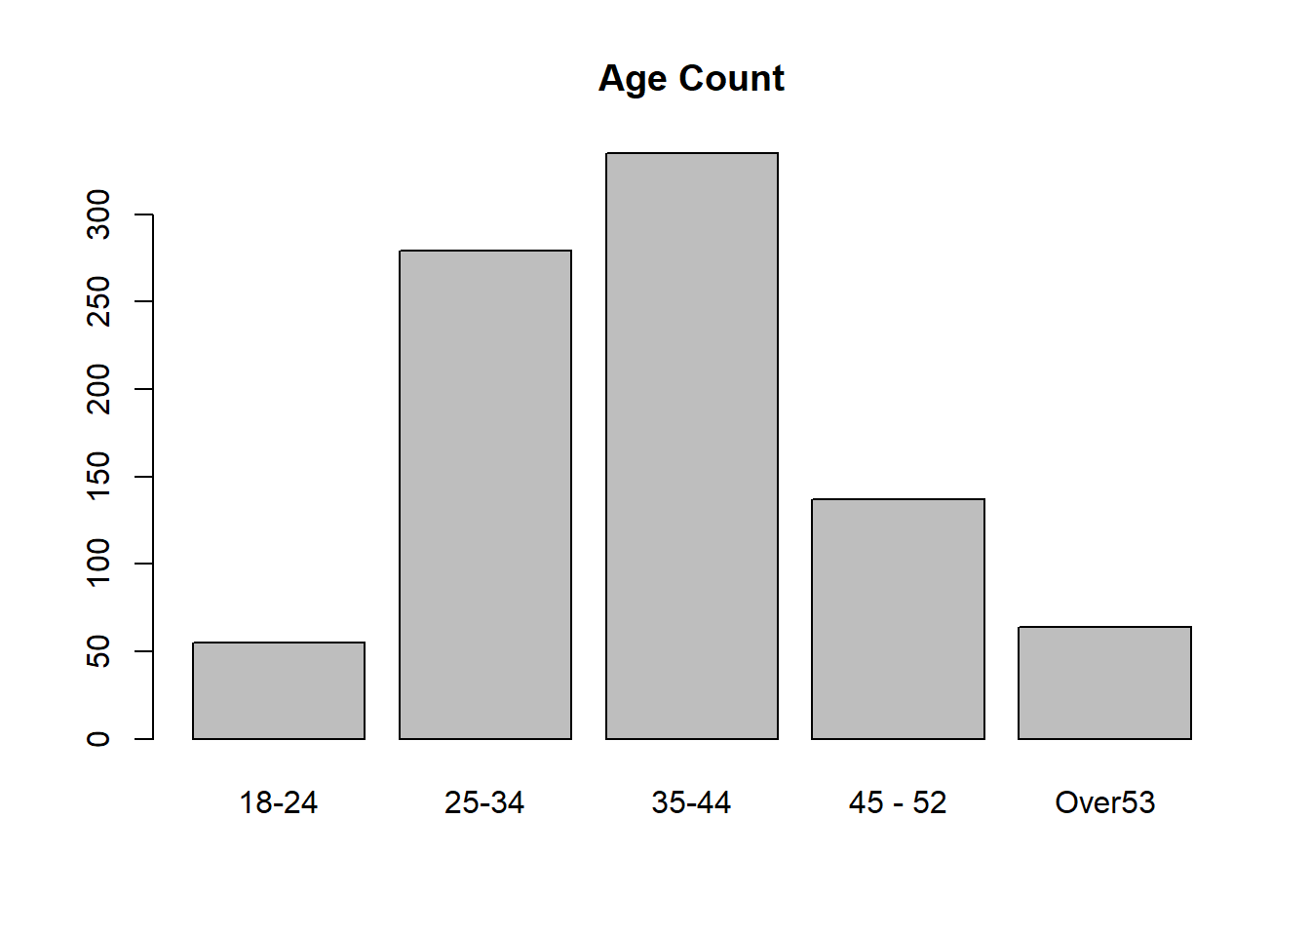
Interesting Trends in Data
Age Buckets
35-44
25-34
45-52

Slide 8
Attrition Model
No Yes
No 203 19
Yes 20 19
Confusion Matrix and Statistics
No Yes
No 203 19
Yes 20 19
Accuracy : 0.8506
95% CI : (0.8014, 0.8915)
No Information Rate : 0.8544
P-Value [Acc > NIR] : 0.6112
Kappa : 0.4059
Mcnemar's Test P-Value : 1.0000
Sensitivity : 0.9103
Specificity : 0.5000
Pos Pred Value : 0.9144
Neg Pred Value : 0.4872
Prevalence : 0.8544
Detection Rate : 0.7778
Detection Prevalence : 0.8506
Balanced Accuracy : 0.7052
'Positive' Class : No
Naïve Bayes
Calculate prior probability for given class
Find likelihood probability for each attribute
Put values in Bayes
Calculate Posterior probability
See which class has higher probability

Slide 9
Attrition Model
Confusion Matrix and Statistics
predTrain
No Yes
No 220 3
Yes 31 7
Accuracy : 0.8697
95% CI : (0.8227, 0.9081)
No Information Rate : 0.9617
P-Value [Acc > NIR] : 1
Kappa : 0.2459
Mcnemar's Test P-Value : 0.000003649
Sensitivity : 0.8765
Specificity : 0.7000
Pos Pred Value : 0.9865
Neg Pred Value : 0.1842
Prevalence : 0.9617
Detection Rate : 0.8429
Detection Prevalence : 0.8544
Balanced Accuracy : 0.7882
'Positive' Class : No
Random Forest
Select Random samples from Attrition
Construct Decision Tree for each sample
Prediction result from each decision
Perform a vote for each predicted result
Select Prediction result with most votes

Slide 10
Attrition Model
Confusion Matrix and Statistics
predTrainsvm
No Yes
No 223 0
Yes 34 4
Accuracy : 0.8697
95% CI : (0.8227, 0.9081)
No Information Rate : 0.9847
P-Value [Acc > NIR] : 1
Kappa : 0.1674
Mcnemar's Test P-Value : 0.00000001519
Sensitivity : 0.8677
Specificity : 1.0000
Pos Pred Value : 1.0000
Neg Pred Value : 0.1053
Prevalence : 0.9847
Detection Rate : 0.8544
Detection Prevalence : 0.8544
Balanced Accuracy : 0.9339
'Positive' Class : No
SVN Model
Segregate given dataset in best possible way
Distance between nearest point as margin
Select Hyperplane with max possible margin

Slide 11
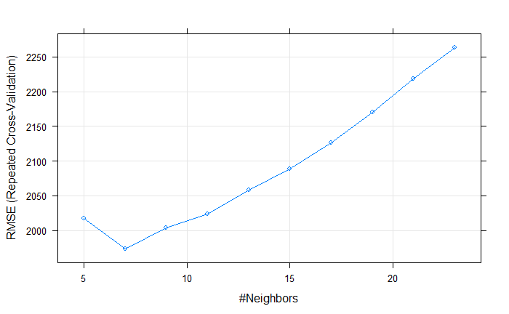
Salary Model
KNN
Calculate distance
Find nearest neighbors
Vote on label
K = 7 optimal

Slide 12
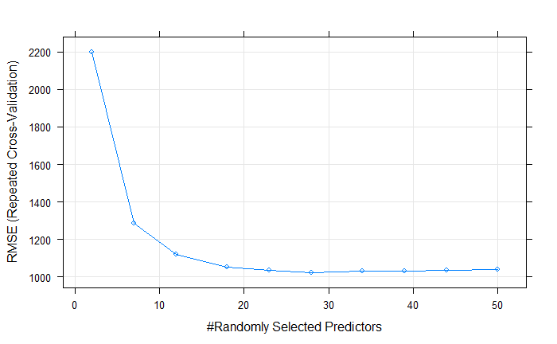
Salary Model
Random Forest
22 Selected Predictor
Repeated CV
$1050 RMSE

Slide 13
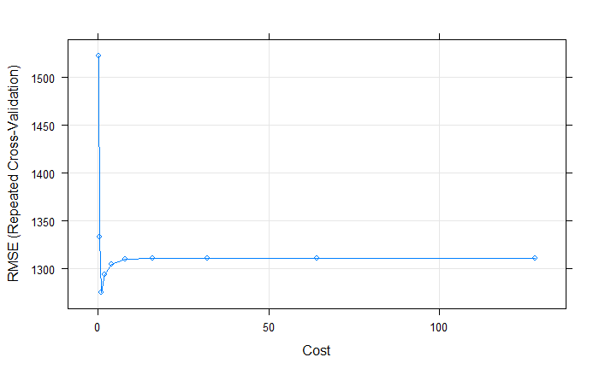
Salary Model
SVN Model
Cost plateaued
RMSE - $1300

Slide 14
Best Models
Attrition
Random Forest Model
Accuracy = 86.97%
Specificity = 87.65
Sensitivity = 70%
Salary
Random Forest Model
22 selected
$1050 RMSE

Slide 15
Conclusion
Random Forest Model for both predictor and classifiers
Based on trees so scaling variables doesn’t matter
Random subspace and bagging to prevent overfitting
Deals with missing data not needed here
Automated feature selection built in
Other than Stock Options, Monthly Income, and Overtime
Age, Total Working Years and Marital Status strong factors for attrition

